Slide 1


ADT, Stack, STL and Doubly Linked List

Slide 2
Abstract Data Type
Abstract
Existing in thought or as an idea but not having a physical or concrete existence.
Consider something theoretically
i.e., A summary of the contents of a book, article, or speech.
The technique used to define new data types independently of their actual representation is called data abstraction.
Data abstraction provides only essential information to the outside world and hiding their background details,
i.e., to represent the needed information in program without presenting the details.

Slide 3
Abstract Data Type – Data abstraction
Data abstraction is a programming and design technique that relies on the separation of interface and implementation.
Let's take one real life example of a TV, which you can turn on and off, change the channel, adjust the volume, and add external components such as speakers, VCRs, and DVD players,
BUT you do not know its internal details, that is, you do not know
how it receives signals over the air or through a cable,
how it translates them, and finally displays them on the screen.
Thus, we can say a television clearly separates its internal implementation from its external interface and you can play with its interfaces like the power button, channel changer, and volume control without having zero knowledge of its internals.

Slide 4
Abstract Data Type – Data abstraction
C++ classes provides great level of data abstraction. They provide sufficient public methods to the outside world to play with the functionality of the object and to manipulate object data, i.e., state without actually knowing how class has been implemented internally.

Slide 5
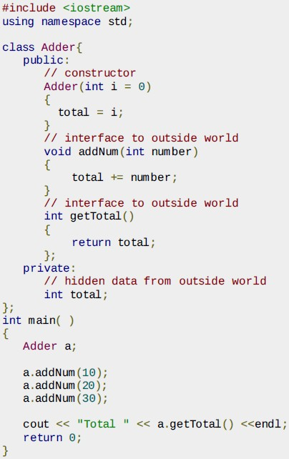
Data abstraction
Any C++ program where you implement a class with public and private members is an example of data abstraction.
The public members addNum and getTotal are the interfaces to the outside world and a user needs to know them to use the class.
The private member total is something that the user doesn't need to know about, but is needed for the class to operate properly.

Slide 6
Abstract Data Type
Abstract data types : A set of data values and associated operations that are precisely specified independent of any particular implementation.
A client (program) can use values of an abstract data type by means of the interface without knowing their actual representation (which can change over time)

Slide 7
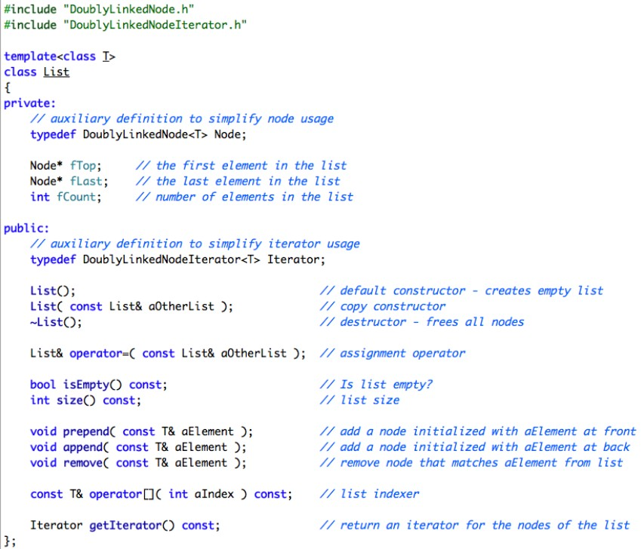
Implement lists as abstract data types

Slide 8
Data Structure: Stack
A stack is an Abstract Data Type (ADT), commonly used in most programming languages. It is named stack as it behaves like a real-world stack
A real-world stack allows operations at one end only.
For example, we can place or remove a card or plate from the top of the stack only.
Stack ADT allows all data operations at one end only. At any given time, we can only access the top element of a stack.

Slide 9
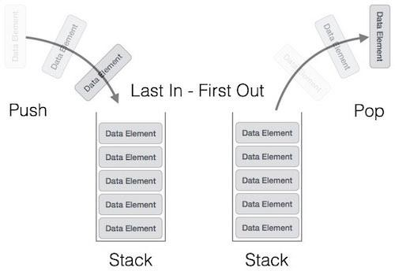
Stack
It is a LIFO data structure. LIFO stands for Last-in-first-out. Here, the element which is placed (inserted or added) last, is accessed first.
In stack terminology, insertion operation is called PUSH operation and removal operation is called POP operation.

Slide 10

Stack operations
We have seen the function push_back().
It appends an element to the end of the controlled sequence.
There is a counterpart function, pop_back(),
It removes the last element in the controlled sequence.

Slide 11
Applications of Stacks
Reversal of input
Checking for matching parentheses
Backtracking (e.g., Prolog or graph analysis)
State of program execution (e.g., storage for parameters and local variables of functions)
Tree traversal
...

Slide 12
Container
A container is a holder object that stores a collection of other objects (its elements). They are implemented as class templates, which allows a great flexibility in the types supported as elements.
The container manages the storage space for its elements and provides member functions to access them, either directly or through iterators (reference objects with similar properties to pointers).

Slide 13
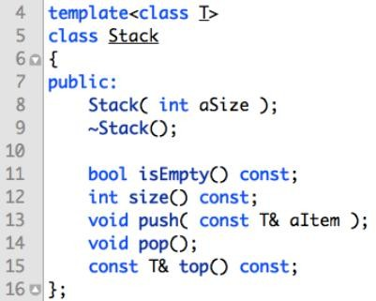
Stack Interface
When defining a container type we wish to minimize the number of value copies required for the objects stored in the container.
In order to achieve this, we use const references (e.g. const T&).
const references will allow us to refer to the actual object or value rather than a mere copy of it.

Slide 14
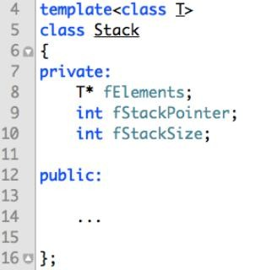
The Stack’s Private abstraction
Inside Stack we need to be able to store objects of type T.
Hence we need to allocate dynamically memory (i.e, an array of type T) and
store the address of the first element in a matching pointer variable.

Slide 15
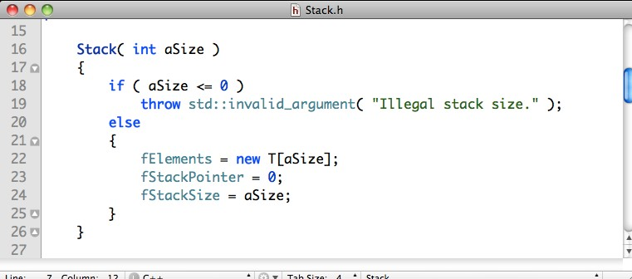
Stack Constructor

Slide 16

Stack Destructor
There are two forms of delete:
delete ptr - release the memory associated with pointer ptr.
delete [] arr - release the memory associated with all elements of array arr and the array arr itself.
Whenever one allocates memory for an array, for example char* arr = new char[10], one must use the array form of delete to guarantee that all array cells are released.

Slide 17
More on delete
int *p_scalar = new int(5);
allocates an integer, set to 5. (same syntax as constructors)
int *p_array = new int[5];
allocates an array of 5 adjacent integers. (undefined values)
delete p_scalar
delete[] p_array

Slide 18
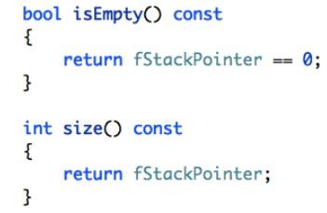
Stack utilities
isEmpty(): Boolean predicate to indicate whether there are elements on the stack.
size(): returns the actual stack size.

Slide 19
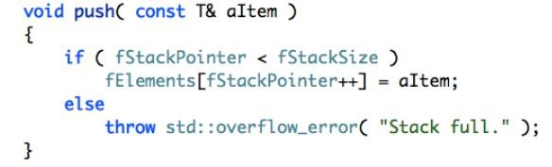
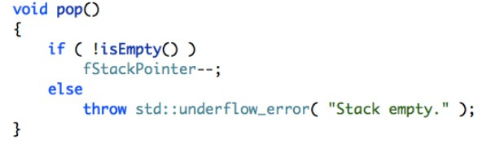
Push and pop
The push method stores a item at the next free slot in the stack, if there is room.
The pop method shifts the stack pointer to the previous slot in the stack, if there is such a slot. Note, the element in the current slot itself is not yet destroyed.

Slide 20
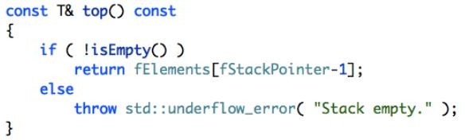
Top
The top method returns a const reference to the item in the current slot in the stack, if there is such a slot.

Slide 21
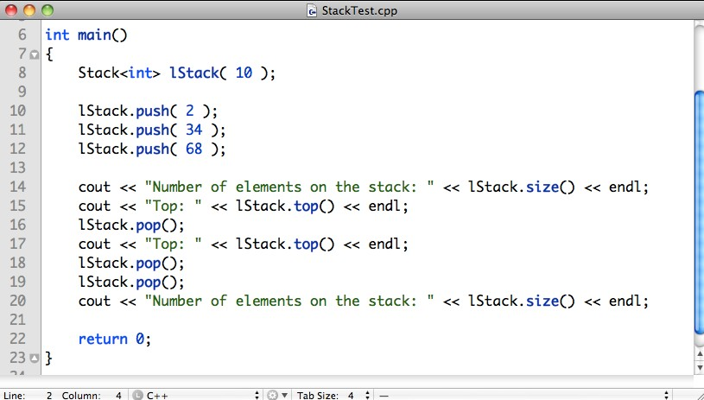
Stack Sample

Slide 22
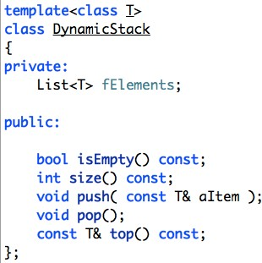
Dynamic Stack
We can define a dynamic stack that uses a list as underlying data type to host an arbitrary number of elements:

Slide 23
Reverse Polish Notation
Reverse Polish Notation (RPN) is a prefix notation wherein operands come before operators.
RPN: a b * c +
Infix: a * b + c

Slide 24
x = 3 * 5 + 29
RPN Calculation using a Stack
store x
add
29
mul
5
3
RPN 3 5*29+
add (44)
29
mul
5
3
29
mul
5
3
mul (15)
5
3
5
3
3

Slide 25
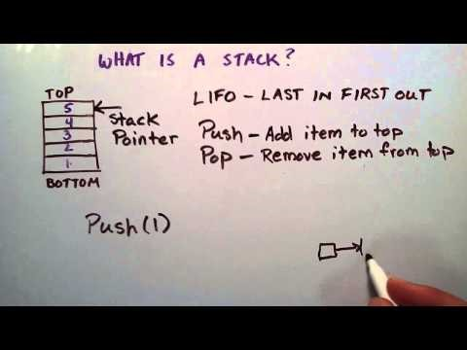
What is a Stack Data Structure
URL: https://www.youtube.com/watch?v=FNZ5o9S9prU

Slide 26
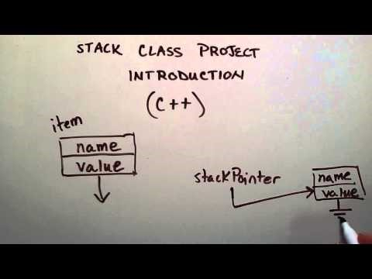
Stack Class (Intro)
URL: https://www.youtube.com/watch?v=rDG6pUveq4o&list=PLTxllHdfUq4eD0L7K2UHU16A_sudFPR_x&index=1

Slide 27
STL of C++ part 1

Slide 28
Containers
The STL makes seven basic containers available, and three derived.
There are two categories of containers in the STL
sequence: vector, list and deque
associative: set, multiset, map and multimap
specialised derived container: stack, queue and priority queue

Slide 29
Vector
Vectors are sequence containers representing arrays that can change in size. (dynamic arrays)
contiguous storage locations
efficiently direct element access as arrays
(unlike array) size can change dynamically
internally vectors do not reallocate each time an element is added/removed to the container.
allocate some extra storage to accommodate for possible growth
Compared to arrays, vectors consume more memory in exchange for the ability to manage storage and grow dynamically in an efficient way.

Slide 30
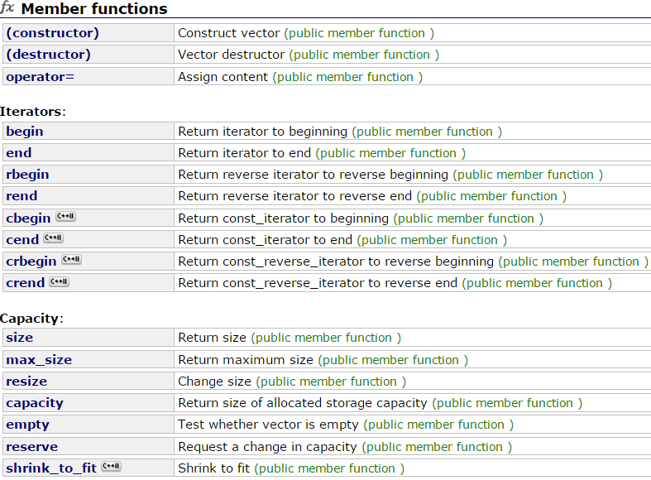
Vector: member function

Slide 31
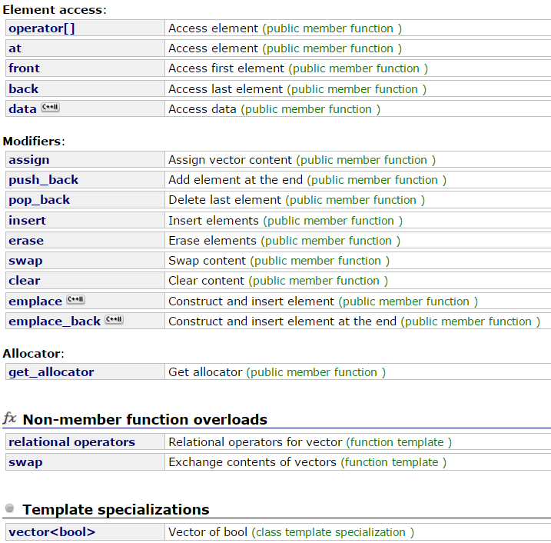
Vector: member function
Reference http://www.cplusplus.com/reference/vector/vector/

Slide 32
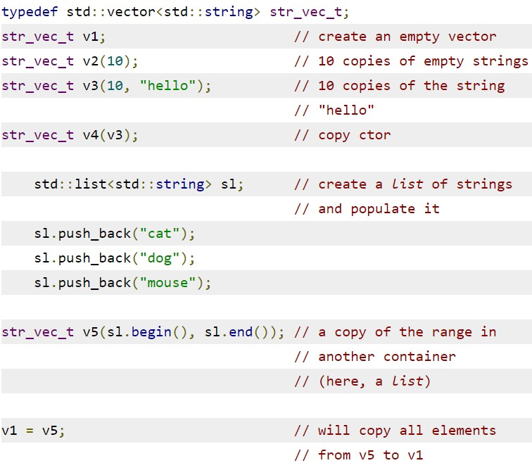
Vector: Constructors

Slide 33
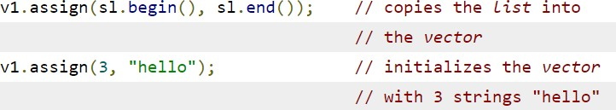
Vector: assign()
The assignment completely changes the elements of the vector.
The old elements (if any) are discarded and the size of the vector is set to the number of elements assigned.
assign() may trigger an internal reallocation.

Slide 34
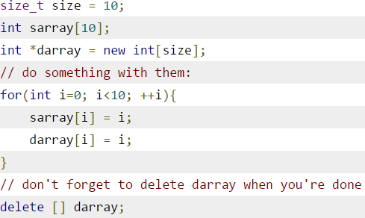
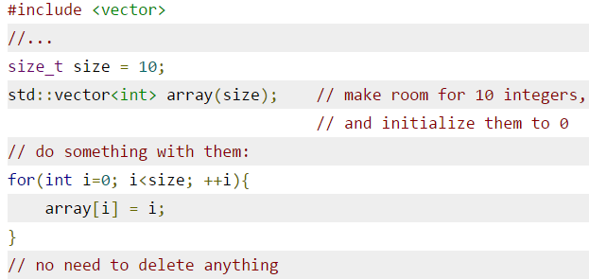
Array vs. vector
static array
(on stack)
dynamic array
(on heap)
It takes a non-const size parameter as the dynamic
Automatically deletes the used memory like the static one
use operator []also it is possible to use at()

Slide 35
Array vs. vector
ordinary array:
fixed size
quick random access by index
slow to insert and erase in the middle
size can’t be changed at runtime
vector
relocating, expandable array
quick random access by index
slow to insert and erase in the middle
quick to insert or erase at end

Slide 36
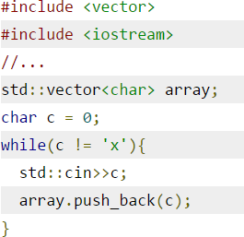
Vector
What if you don't know how many elements you will have?
implement a logic that allows to grow your array from time to time (complicated)
allocate an array that is "big enough.“ (expensive and poor practice)
not the case for vector
push_back() appends one element at a time to the array.
You can push_back() elements until the allocated memory is exhausted
Then, vector will trigger a
reallocation and will grow the allocated memory block
move(copy) to a larger block.
slow down your application dramatically.
vector has a so-called 'controlled sequence' and a certain amount of allocated memory for that sequence.
The controlled sequence is
just another name for the array in the guts of the vector. To hold this array, vector will allocate some memory, mostly more than it needs.

Slide 37
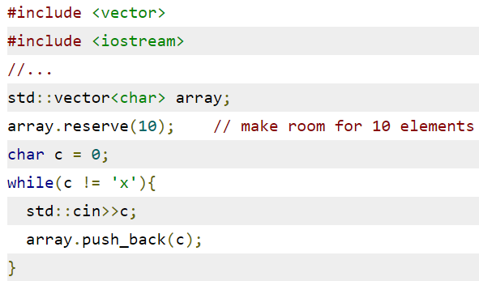
Vector
In the previous example, we declared the vector using its default constructor. This creates an empty vector.
Depending on the implementation of the Standard Library being used, the empty vector might or might not allocate some memory "just in case."
If we want to avoid a too-often reallocation of the vector's storage, we can use its reserve() member function:
If the vector already has room for the required number of elements,
reserve() does nothing.
In other words, reserve() will grow the allocated storage of the vector, if necessary, but will never shrink it.
The function reserve() will ensure that we have room for at least 10 elements in this case

Slide 38
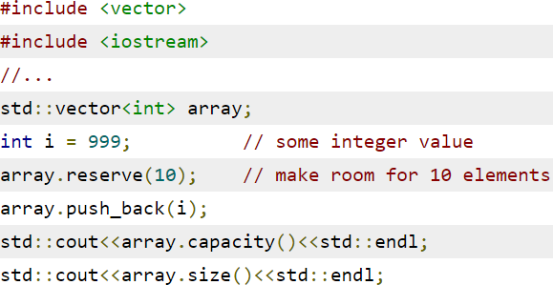
Vector – size and capacity
For this example, only 0 is a valid index for array.
We have made room for at least 10 elements with reserve(), but the memory is not initialized
array.at() returns out_of_range if it access other elements
the role of reserve() is to minimize the number of potential reallocations and that it will not influence the number of elements in the controlled sequence
A call to reserve() with a parameter smaller than the current capacity() is benign—it simply does nothing.

Slide 39
Vector - resize
The correct way of enlarging the number of contained elements is to call vector's member function resize().
If the new size is larger than the old size of the vector, it will preserve all elements already present; the rest will be initialized according to the second parameter.
If the new size is smaller than the old size, it will preserve only the first new_size elements. The rest is discarded and shouldn't be used any more—consider these elements invalid.
If the new size is larger than capacity(), it will reallocate storage so all new_size elements fit. resize() will never shrink capacity().

Slide 40
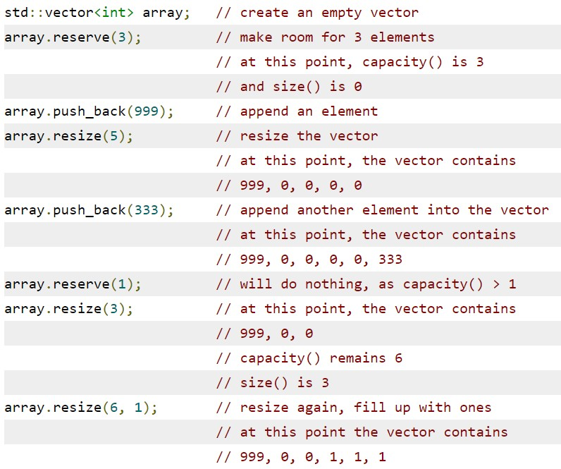
Vector - resize example

Slide 41

Vector
Another constructor provided by vector.
It takes two parameters: a pointer to the first element of a C- style array and a pointer to one past the last element of that array

Slide 42
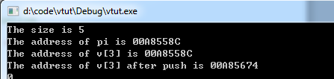
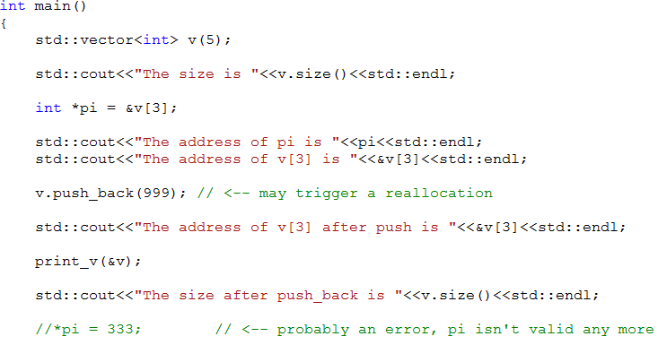
Vector
When taking the address of elements contained in a vector, there is something you have to watch out for: an internal reallocation of the vector will invalidate the pointers you hold to its elements.

Slide 43
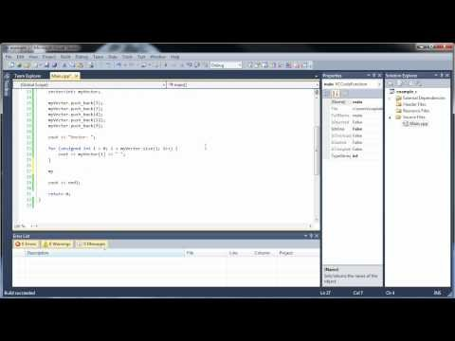
Vectors and Vector Functions
URL: https://www.youtube.com/watch?v=Cq1h1KPoGBU

Slide 44
Iterator
Iterators are the way the Standard Library models a common interface for all containers—vector, list, deque, set and so on.
The reason is that operations that are "natural" for one container (like subscripting for vector) do not make sense for other containers.
The Standard Library needs a common way of applying algorithms like iterating, finding, sorting to all containers—thus the concept of iterators.
iterators are generalisation of the concept of points to contained elements.

Slide 45
Iterator
Iterating: a process of moving sequentially from element to element.
increment iterator with ++ operator
so it points to next element in the container
decrement iterator with – operator
so it points to previous element in the container
dereference iterator with *
so you can get the content/value of the element it points to.
In STL, an iterator is represented by an object of an iterator class

Slide 46
Iterator for Vector
The important thing is that if you have an iterator, you can dereference it to obtain the element it "points" to
what is dereferencing? : get you a reference to the actual object the pointer/iterator is pointing to
Dereferencing a pointer/iterator means getting the value that is stored in the memory location pointed by the pointer/iterator.
For vector the most natural implementation of an iterator is indeed a plain pointer— but don't count on this

Slide 47
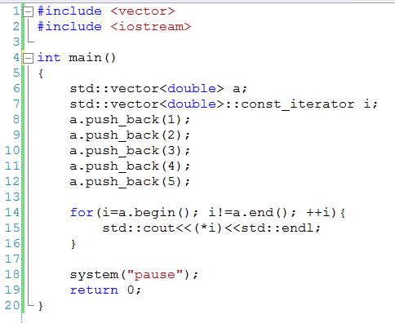
Iterator for Vector
This declares a const iterator i for a vector<double>. We are using a const iterator because
we do not intend to modify the contents of the vector.
The member function begin()
returns an iterator that "points"
to the first element in the sequence.
The member function end() returns an iterator that "points" to one-past-the-last- element in the sequence.

Slide 48
Iterator for Vector
dereferencing the iterator returned by end() is illegal and has undefined results. e.g.
std::cout<<*(a.end())<<std::endl;
The last element is *(a.end()-1)

Slide 49
Why bother with iterators at all?
The answer is that we have to use iterators if we want to apply some standard algorithm, like sorting, to the vector.
The Standard Library does not implement the algorithms as member functions of the various containers, but as free template functions that can operate on many containers
Implementing an iterator as separate type allows additional functionality.
Consistency with other containers. Pointers may not make sense to other types of containers.

Slide 50
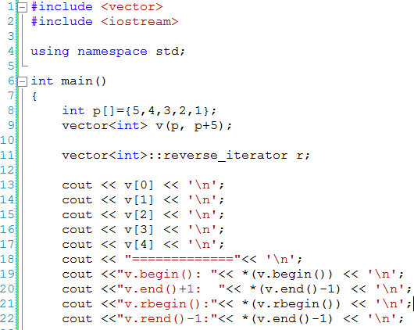
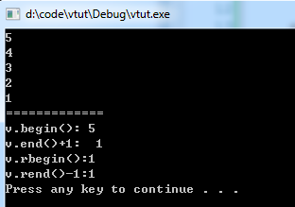
Vector: iterator- element content
begin() and end() point to the first, respectively, to one-past-the-last element.
rbegin() and rend() point to the first, respectively, to the one-past- the-last element of the reverse sequence.

Slide 51
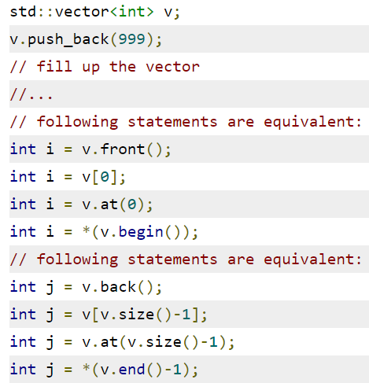
Element access

Slide 52
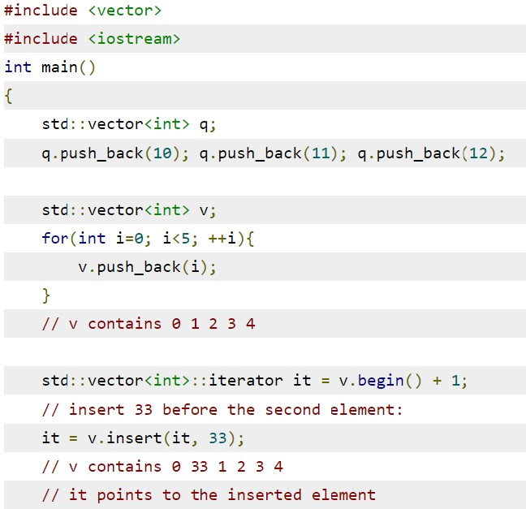
Vector: iterator- element content

Slide 53
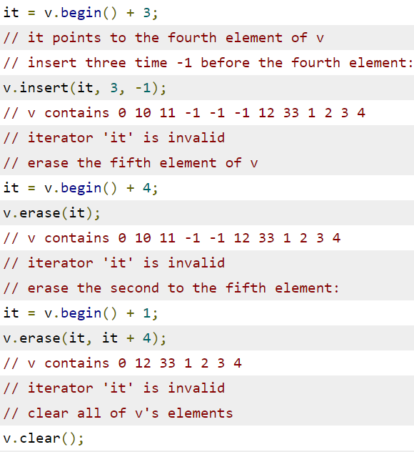
Vector: iterator- element content
insert() and erase() may invalidate any iterators you might hold
Erasing elements never triggers a reallocation, nor does it influence
the capacity(). However, all iterators that point between the first element erased and the end of the sequence become invalid.
Calling clear() removes all elements from the controlled sequence. The memory allocated is not freed, however. All iterators become invalid

Slide 54
Comparison operations
You can compare the contents of two vectors on an element- by-element basis using the operators ==, != and <.
Two vectors are equal if both have the same size() and the elements are correspondingly equal.
Note that the capacity() of two equal vectors need not to be the same. The operator < orders the vector's lexicographically.
https://www.quora.com/Whats-the-difference-between-lexicographical-and-alphabetical-order

Slide 55
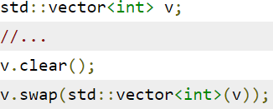
Vector: Swapping contents
Sometimes, it is practical to be able to swap() the contents of two vectors.
A common application is forcing a vector to release the memory it holds. We have seen that erasing the elements or clearing the vector doesn't influence its capacity()(in other words, the memory allocated).

Slide 56
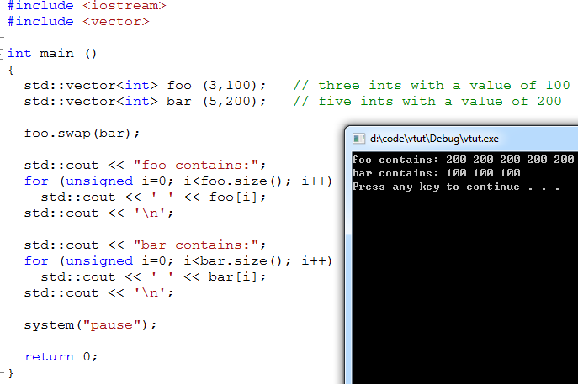
Vector: Swapping contents

Slide 57
List
each element contains a pointer not only to the next element but also to the preceding one.
The container stores the address of both the front and also the back elements
the front: the first element
the back: the last element
This ensures the fast access of both ends of the list.

Slide 58
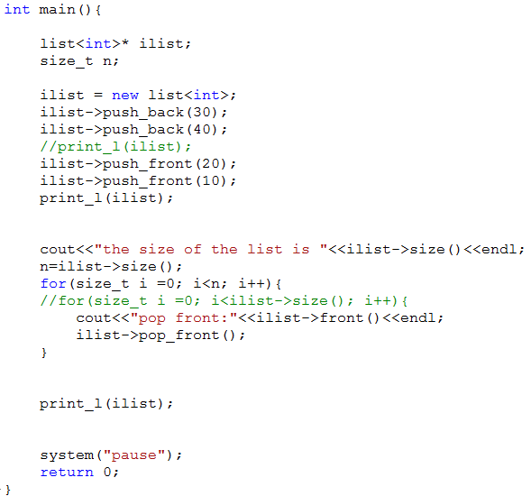
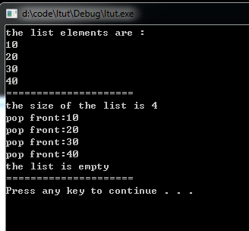
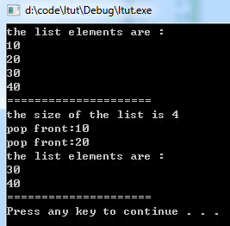
List: push_front, front, pop_front

Slide 59
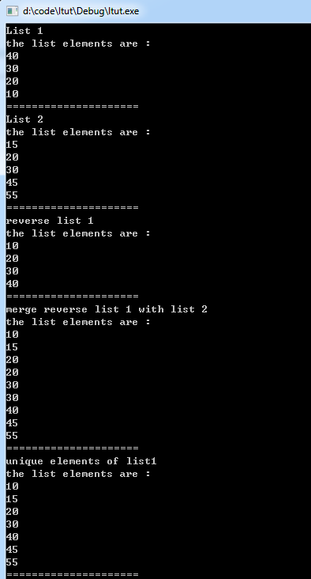
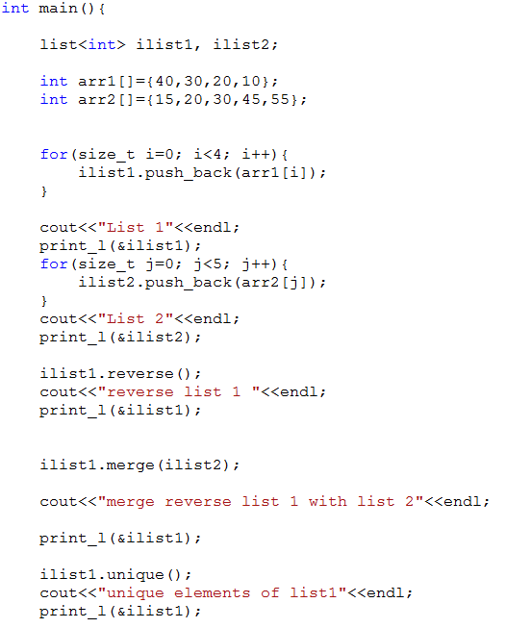
List: reverse(), merge() and unique()

Slide 60
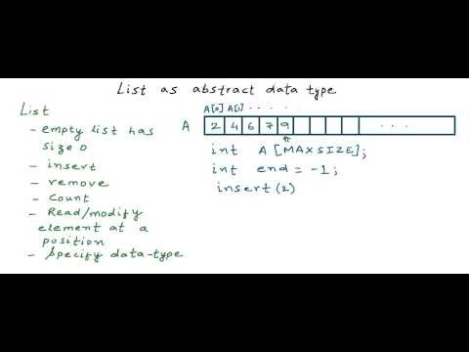
List as an Abstract Data Type (ADT)
URL: https://www.youtube.com/watch?v=HdFG8L1sajw

Slide 61
Deque
Deque is short for Double-Ended Queue
A deque is like
a vector : it supports random access using [] operator
a linked list: can be access from front and end
a double ended vector and supports push_front(),pop_front () and front().
Deque stores data in several different non-contiguous memory location.(segmented)

Slide 62
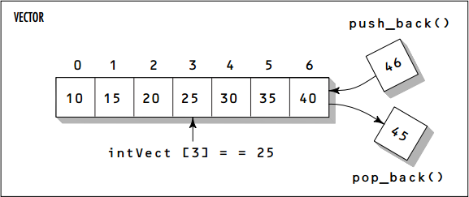
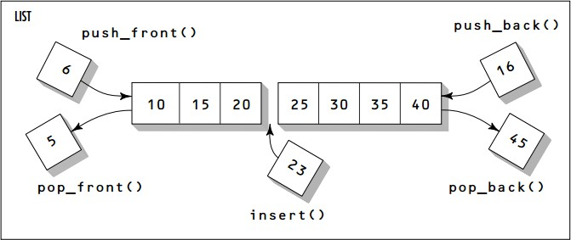
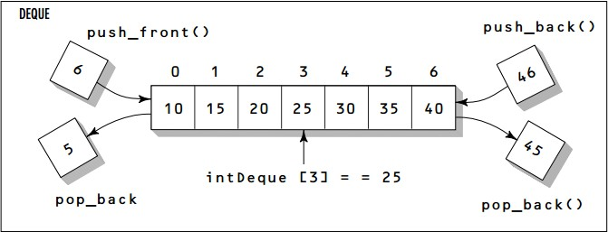
Vector, List and Deque

Slide 63

Deque
URL: https://www.youtube.com/watch?v=sQj1rmJ1q2A

Slide 64
Doubly Linked List

Slide 65






What is a singly-linked list?
A singly-linked list is a sequence of data items, each connected to the next by a pointer called next.
Data
Data
Data
Nil
A data item may be a primitive value, a composite value, or even another pointer.
A singly-linked list is a recursive data structure whose nodes refers to nodes of the same type.

Slide 66









What is doubly-linked list?
Nil
Data
Data
Data
Nil
A doubly-linked list is a sequence of data items, each connected by two links called next and previous.
A data item may be a primitive value, a composite value, or even another pointer.
Traversal in a double-linked list is bidirectional.
Deleting of a node at either end of a doubly-linked list is straight forward.

Slide 67
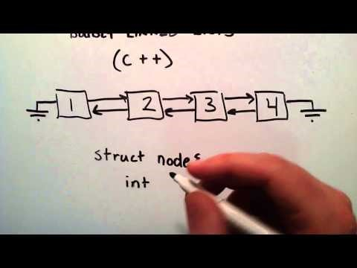
What is a Doubly Linked List
URL: https://www.youtube.com/watch?v=k0pjD12bzP0

Slide 68
Sentinel Node: NIL
A sentinel node is a programming idiom used to replace null-pointers with a special token denoting “no value” or nil.
Sentinel nodes behave like null-pointers. However, unlike null-pointers, which refer to nothing, sentinels denote proper, yet empty, values.

Slide 69
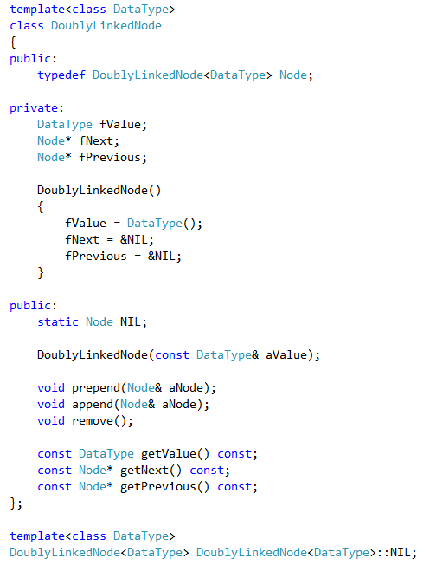
A Doubly-Linked List Node

Slide 70
Template Implementation: Variant A
#pragma once
template<class DataType> class DoublyLinkedNode
{
private:
Implementation within template class specification
…
public:
…
void prepend( Node& aNode )
{
aNode.fNext = this;
// aNode becomes left node of this
// make this the forward pointer of aNode
if ( fPrevious != &NIL )
{
aNode.fPrevious = fPrevious; fPrevious->fNext = &aNode;
}
// make this's backward pointer aNode's
// backward pointer and make previous'
// forward pointer aNode
fPrevious = &aNode;
// this' backward pointer becomes aNode
}
…
};

Slide 71
Template Implementation: Variant B
#pragma once
Implementation outside template class specification, but within same header file
template<class DataType> class DoublyLinkedNode
{
…
};
template<class DataType>
void DoublyLinkedNode<DataType>::prepend( Node& aNode )
{
aNode.fNext = this; // make this the forward pointer of aNode
if ( fPrevious != &NIL )
{
aNode.fPrevious = fPrevious; fPrevious->fNext = &aNode;
}
// make this's backward pointer aNode's
// backward pointer and make previous'
// forward pointer aNode
fPrevious = &aNode;
// this' backward pointer becomes aNode
}

Slide 72
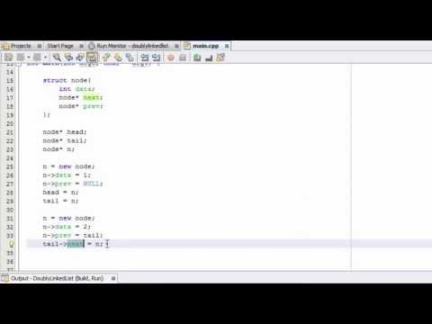
How to Create a Doubly Linked List (Part 1)
URL: https://www.youtube.com/watch?v=YJRRpXYldVQ

Slide 73
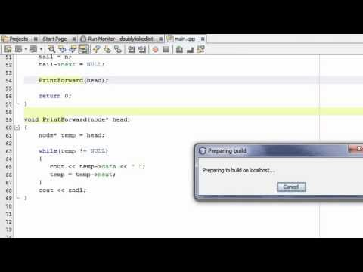
How to Create a Doubly Linked List (Part 2)
URL: https://www.youtube.com/watch?v=5s0x8bc9DvQ

Slide 74
End of ADT, Stack, STL and Doubly Linked List

